Slide 1
Transparency into $5 Trillion:
How the PRAC Protects Pandemic Relief Funds
Pandemic Response Accountability Committee (PRAC)
March 16, 2022

Slide 2
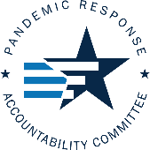
The PRAC oversees $5 trillion in pandemic relief
$15.4B
The Families First Coronavirus Response Act
$7.8B
The Coronavirus Preparedness and Response Supplemental Appropriations Act, 2020
Signed into law on March 18, 2020, the FFCR Act provided paid sick leave, tax credits, and free COVID-19 testing, while also expanding food assistance and unemployment benefits.
Signed into law on March 6, 2020, the Act provided emergency funding to Health and Human Services, the State Department, and the Small Business Administration.
$5+
Trillion
$2.1T
The Coronavirus Aid, Relief, and Economic Security Act
$1.9T
American Rescue Plan Act of 2021
Signed into law on March 11, 2021, this legislation includes direct payments, unemployment benefits, and tax provisions as well as support for small businesses and schools.
Signed into law on March 27, 2020, the CARES Act created the Paycheck Protection Program, provided tax rebates to individuals, and provided relief to federal agencies.
$900B
The Coronavirus Response and Relief Supplemental Appropriations Act, 2021
$483B
Paycheck Protection Program
and Health Care Enhancement Act
Signed into law on December 27, 2020, this legislation extended federal unemployment benefits, provided direct payments to individuals, and started a second round of PPP loans.
Signed into law on April 24, 2020, the Act added funds to the Paycheck Protection Program (PPP) and other SBA programs.

Slide 3
U.S. pandemic relief spending in context
2009
Recovery Act
FY19
Total Spending
2020-2021 Pandemic
$ in Trillions

Slide 4
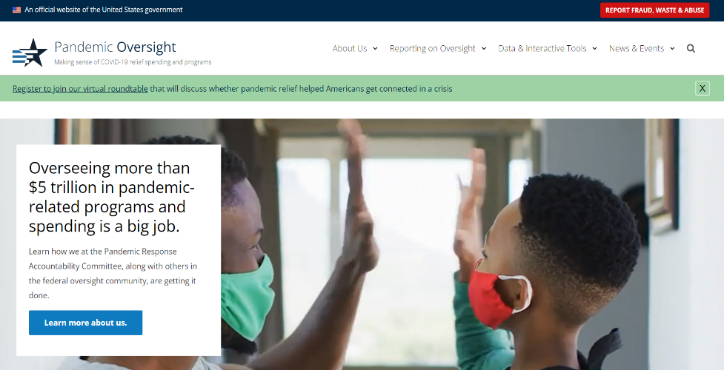
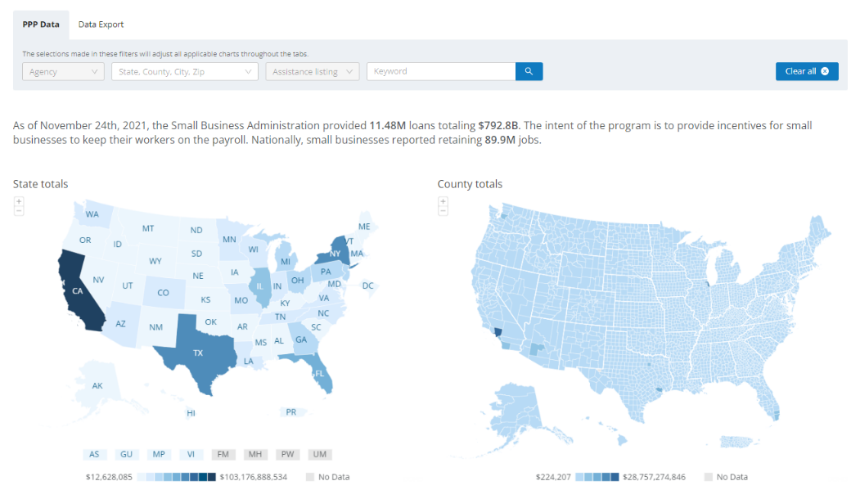
Tracking the money on PandemicOversight.gov

Slide 5
Fighting pandemic-related fraud
Pandemic Analytics Center of Excellence (PACE)
Identity Fraud Reduction & Redress Working Group
Fraud Task Force
1272 Indictments
949 Arrests
455 Convictions

Slide 6
Connecting federal, state, and local oversight entities
Regular listening posts meet monthly
Participants include:
Discuss key issues or areas of priority
Single Audit Requirements
OMB Guidance
Fraud Alerts and “Early Warnings”
PRAC
State Auditors
Local Auditors
NASACT
GAO
Federal OIG Staffs
AICPA
OMB
Auditors for Tribes

Slide 7
Connecting with State Auditors: State Auditor-in-Residence
WHAT: 6- to 12-month detail with the PRAC
Work on cross-cutting projects
Network with federal OIG staff
Participate in subcommittee and other coordination meetings
WHO: Piloting with 1 or 2 mid-level or senior auditor staff from state auditors’ offices on rotation

Slide 8
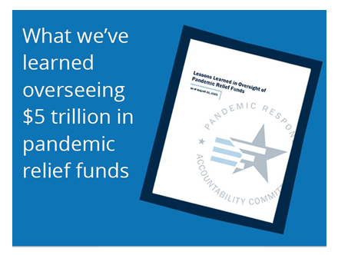
Identifying lessons learned and risks that cross agency and program boundaries
The PRAC and its members have issued 360+ oversight reports. We've covered a lot and recommended a lot.
Our new report breaks it all down to five basics.
1. Verify eligibility before sending money
2. Give underserved communities better access to relief funds
3. Use existing data to prevent fraud
4. Get guidance out quickly and accurately
5. Let the public see who got grants and loans

Slide 9
Resources: Stakeholder Listening Sessions
Did pandemic relief reach the underserved?
You can watch video recaps of 9+ events at
PandemicOversight.gov
Receive invites right in your inbox by signing up for our email newsletters

Slide 10
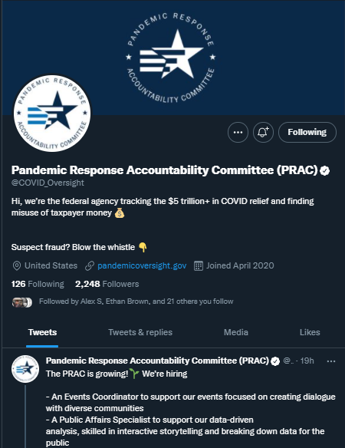
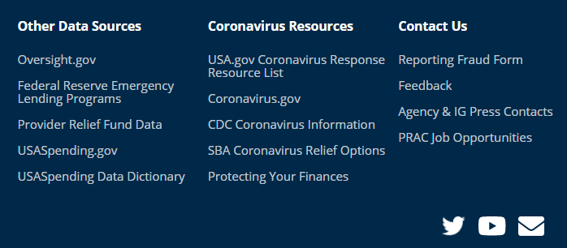
Connect with the PRAC | Newsletter and Social Media
Sign up for our emails and follow us on Twitter
example@website.com
Subscribe

